Slide 1

AI-Based Intelligent Truck Monitoring
and Risk Assessment System
Team Members:
Yogesh Zakkiudeen Bismil Thausif Sha.k
23619240 23619241 23619204
Guide Name:
Ms. Usha Ms. Janani
Assistant Professor Assistant Professor
Department of Computer Science and Engineering (AI & ML)
Vels Institute of Science, Technology and Advanced Studies (VISTAS)
Academic Year 2026 – 2027

Slide 2
01
Abstract
Conventional truck monitoring relies on manual observation and disconnected tools for vehicle identification, speed checks and security verification — making continuous, reliable surveillance difficult.
This project proposes an AI-Based Intelligent Truck Monitoring and Risk Assessment System that unifies these tasks into a single, truck-specific computer-vision pipeline built around a live CCTV feed.
The system detects trucks, maintains a persistent identity per vehicle (multi-object tracking), and runs parallel modules for speed estimation, ALPR, and multi-task truck classification (type, colour, attributes).
Recognised plates are checked against a blocklist; overspeeding, blocklisted or suspicious vehicles trigger real-time sound, dashboard and email/SMS alerts.
All data is stored in MySQL, served through a Flask REST API, and presented on a React dashboard for live monitoring, vehicle-history search, alerts and analytics.
1

Slide 3
02
Base Paper
Summary
The base paper improves the YOLOv8n detector using lightweight convolutional modules to reduce model size without significant accuracy loss, and pairs it with the BoT-SORT tracker for multi-object vehicle tracking. It reports a reduced parameter count and improved tracking stability on the UA-DETRAC benchmark.
Relevance to this Project
This project adopts the base paper's core idea — a lightweight detector paired with a dedicated multi-object tracker — as Modules 2 and 3 of the proposed pipeline. However, the base paper only covers generic vehicle detection/tracking on a benchmark dataset. This project extends that foundation into a full truck-specific system by adding ALPR, multi-task truck classification, speed estimation, blocklist verification, risk-based alerting and a complete database-backed dashboard.
Title
Vehicle Detection and Tracking Based on Improved YOLOv8
Authors / Venue
Liu & Shen — IEEE Access, 2025
2

Slide 4
03
Problem Statement
Conventional truck monitoring depends heavily on manual observation and separate, disconnected systems for vehicle identification, speed monitoring and security checking.
This makes continuous monitoring difficult and delays detection of overspeeding, suspicious vehicles, or mismatches between an observed vehicle's characteristics and its registered information.
Existing research mostly focuses on individual tasks — such as detection/tracking or license-plate recognition — rather than a single, integrated, truck-specific risk-assessment workflow.
This project addresses that gap by developing a computer-vision system that detects and tracks trucks, recognises plates, retrieves registered vehicle information, verifies attributes, analyses speed and security status, and generates real-time alerts.
3

Slide 5
04
Objectives
1
Design a real-time truck detection module using a lightweight YOLO-based detector for live CCTV streams.
6
Integrate a blocklist-verification mechanism that cross-checks recognised plates against flagged vehicles.
2
Implement persistent multi-object tracking (ByteTrack) so every detected truck retains a stable identity across frames.
7
Develop a risk/event-analysis engine that fuses overspeed, blocklist and suspicious-attribute signals.
3
Develop a trajectory-based speed-estimation module and flag vehicles exceeding a configurable speed limit.
8
Implement a real-time, multi-channel alert system (sound, dashboard, email/SMS) for authorised personnel.
4
Build an ALPR module using PaddleOCR for accurate plate extraction under varied lighting and viewing conditions.
9
Build a MySQL database, Flask REST API backend, and a React dashboard for monitoring, search, alerts and analytics.
5
Design a multi-task classification module (MTL-ViT) predicting truck type, colour and visual attributes.
4

Slide 6
05
Literature Review (Papers 1–4)
# | Paper Title & Year | Summary | Limitation
1 | Vehicle Detection and Tracking Based on Improved YOLOv8 — Liu & Shen (IEEE Access, 2025) [BASE PAPER] | Improves YOLOv8n with lightweight modules; pairs with BoT-SORT for tracking. Reduced model size, improved tracking on UA-DETRAC. | General vehicle detection/tracking only — no truck-specific ALPR, lookup, attribute verification, speed/risk analysis or alerting.
2 | Integrated License Plate Recognition Using YOLO and CNN (IEEE ICISC, 2025) | Combines YOLOv8, a CNN and EasyOCR for plate detection, feature extraction and character recognition. | Primarily LPR-focused; lacks persistent tracking, database verification and integrated risk assessment.
3 | Real-Time Vehicle Classification & LPR via Deformable Convolution-Based YOLOv8 (IEEE Sensors Journal, 2024) | Combines classification and LPR with an improved YOLOv8 for difficult lighting, resolution and weather. | No complete truck-monitoring workflow with tracking, speed estimation, blocklist checking or risk fusion.
4 | License Plate Detection using YOLOv8 & OCR Benchmarking — EasyOCR, PaddleOCR, Tesseract (IEEE, 2024) | Uses YOLOv8 for plate detection; benchmarks OCR engines for character recognition. | Focuses on plate/OCR benchmarking rather than tracking, registered-vehicle verification or risk management.
5

Slide 7
05
Literature Review (Papers 5–7)
# | Paper Title & Year | Summary | Limitation
5 | Vehicle Number Plate Recognition in ITS using YOLOv8 and EasyOCR (IEEE CITSM, 2023) | Uses YOLOv8 for plate detection and EasyOCR for character reading; reports close to 95% accuracy. | Mainly ALPR-oriented — no truck-specific tracking, speed estimation, database verification or risk assessment.
6 | Automatic License Plate Recognition System in Indonesia Using YOLOv8 and EasyOCR (IEEE ICOIACT, 2023) | Uses YOLOv8 and EasyOCR on 869 vehicle/plate images; reports close to 94% accuracy. | Focused on regional plates and ALPR only; lacks truck-monitoring, attribute verification and risk-alert pipeline.
7 | Automated License Plate Detection & Recognition using YOLOv8 and OCR with a Tello Drone Camera (IEEE IC3INA, 2023) | Uses a drone-mounted camera with YOLOv8 and Pytesseract for plate recognition and e-ticketing. | Small evaluation set; drone setup differs from fixed-CCTV truck monitoring, lacks database/risk fusion.
6

Slide 8
06
Research Gap
No surveyed work combines detection, persistent tracking, ALPR, truck-specific classification, speed estimation, blocklist verification and risk-based alerting into a single deployable pipeline.
Detection/tracking papers (including the base paper) target generic vehicle datasets — not truck-specific classification, registered-vehicle lookup or downstream risk decisions.
ALPR-focused papers treat plate recognition as standalone — a recognised plate cannot be linked back to a tracked vehicle's speed or behaviour over time.
None of the reviewed systems include a database-backed blocklist check or a multi-channel real-time alert mechanism.
Existing systems stop at detection/recognition accuracy — no end-to-end dashboard for monitoring, historical search and analytics.
7

Slide 9
07
Proposed Methodology
1
Video frames from a CCTV/IP camera are passed to a YOLO-based truck detector, which localises each truck with a bounding box.
2
ByteTrack assigns each vehicle a stable Track ID, retained as it moves across frames — this identity links every downstream measurement to one vehicle.
3
In parallel: speed is estimated from the tracked trajectory, PaddleOCR (ALPR) reads the number plate, and MTL-ViT predicts truck type, colour and attributes.
4
The recognised plate is verified against a blocklist database; overspeed, blocklist or suspicious-attribute signals feed the risk/event-analysis stage.
5
A positive risk decision triggers the alert-management module (sound, dashboard, email/SMS) for authorised personnel.
6
Every detection, measurement and event is logged to MySQL via a Flask REST API, driving a React dashboard for live monitoring, history, alerts and analytics.
8

Slide 10
08
System Architecture
Thirteen modules organised into four functional layers — data flows top to bottom.
Layer 1
Input & Perception
Input
Acquisition
Truck Detection
(YOLO)
Multi-Object
Tracking
Layer 2
Parallel Analysis
Speed
Estimation
ALPR
(PaddleOCR)
Truck Classification
(MTL-ViT)
Blocklist
Verification
Layer 3
Decision & Alerting
Risk / Event
Analysis
Alert
Management
Operational
Analysis
Layer 4
Data & Presentation
Data Storage
(MySQL)
Backend
(Flask API)
Web Dashboard
(React)
9

Slide 11
08
System Architecture — Module Walkthrough
Input Acquisition — Captures the live CCTV/video stream feeding the entire pipeline.
Risk / Event Analysis — Fuses overspeed, blocklist and suspicious-vehicle signals into a risk decision.
Truck Detection (YOLOv26) — Localises trucks in each frame; produces bounding boxes.
Alert Management — Raises real-time sound, dashboard and email/SMS alerts.
Multi-Object Tracking (ByteTrack) — Assigns and maintains a unique Track ID per truck across frames.
Operational Analysis — Tracks cargo, arrival/departure detection and visit records.
Speed Estimation & Analysis — Derives vehicle speed from the tracked trajectory; flags overspeeding.
Data Storage (MySQL) — Persists vehicle info, plates, speed, attributes, events and alerts.
License Plate Recognition (PaddleOCR) — Detects the plate region and reads the registration number.
Backend Service (Flask API) — Handles data processing, endpoints, business logic and authentication.
Truck Classification (MTL-ViT) — Predicts truck type, colour and visual attributes with confidence scores.
Web Dashboard (React) — Presents live monitoring, history search, alerts and analytics/reports.
Blocklist Verification — Matches the recognised plate against a blocklist database.
AI-Based Intelligent Truck Monitoring and Risk Assessment System
10

Slide 12
09
Hardware & Software Requirements
Hardware Requirements
Software Requirements
Component | Specification
CCTV / IP Camera | Fixed, weatherproof, night-vision, min. 2 MP, RTSP/HTTP streaming
Processing Unit | Workstation/server with CUDA-capable GPU (RTX-class, 8 GB+ VRAM)
Memory (RAM) | 16 GB or higher for concurrent detection, tracking and OCR
Storage | SSD local storage plus network storage/NAS for video & DB backups
Network | Stable LAN/Wi-Fi between cameras, server and dashboard clients
Display | Monitor/workstation for live dashboard and alert viewing
Category | Tools / Technologies
Programming Language | Python 3.x (AI/ML); JavaScript/JSX (dashboard)
Detection & Tracking | YOLO (Ultralytics-based), ByteTrack, OpenCV
Recognition & Classification | PaddleOCR (ALPR), PyTorch-based MTL-ViT
Backend | Flask (REST API), SQLAlchemy / PyMySQL
Database | MySQL 8.x
Frontend | React.js, Node.js, npm
Dev Tools / OS | VS Code, Git & GitHub, Postman · Ubuntu 22.04 / Windows 10-11
AI-Based Intelligent Truck Monitoring and Risk Assessment System
11

Slide 13
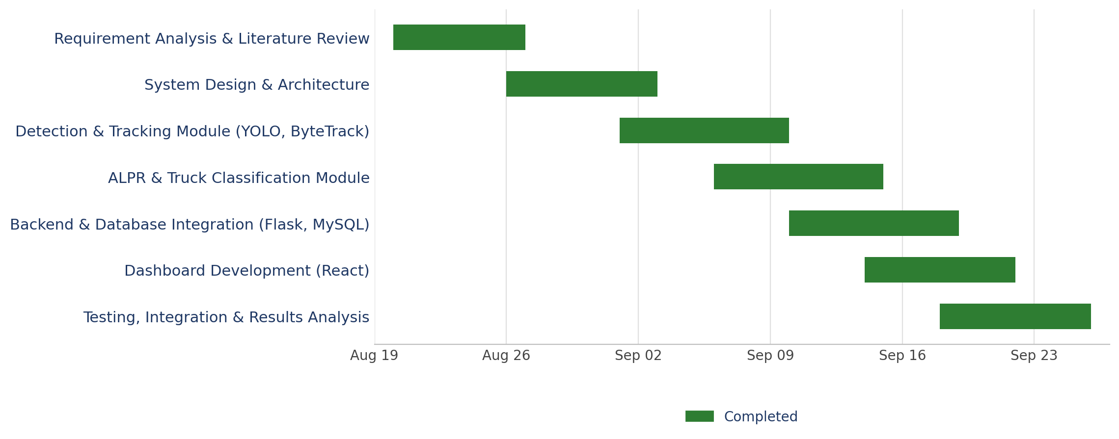
09
Gantt Chart
Project timeline (Aug 20 – Sep 26, 2026) across design, development and testing phases
12

Slide 14
10
System Design
System Layers
Actors
Perception Layer
Detection, tracking, ALPR and classification running on the processing server; produces structured events.
Authorised Personnel
Views live monitoring, receives alerts and searches vehicle history via the dashboard.
Application Layer
Flask exposes REST endpoints, applies business logic (risk fusion, authentication) and mediates DB reads/writes.
System Administrator
Manages camera configuration, blocklist entries and user access.
Presentation Layer
React consumes the APIs to render live monitoring, search, alerts and analytics to authorised users.
System (automated)
Continuously runs the detection-to-alert pipeline without manual intervention.
13

Slide 15
10
System Design — Database (MySQL)
Entity | Key Attributes | Purpose
Vehicle | vehicle_id, track_id, first_seen, camera_id | Represents one physically tracked truck
PlateRecord | plate_id, vehicle_id, plate_number, confidence | Stores recognised license-plate results
SpeedRecord | record_id, vehicle_id, speed_kmph, timestamp | Stores per-vehicle speed measurements
TruckAttribute | vehicle_id, truck_type, colour, body_type, confidence | Stores classification results
EventAlert | event_id, vehicle_id, event_type, risk_level, timestamp | Stores overspeed / blocklist / suspicious events
CameraInfo | camera_id, location, ip_address, resolution | Stores camera metadata for each monitored site
14

Slide 16
11
Flowchart
Frame-level processing logic, from capture through to database logging and alert decisions.
Capture CCTV Frame
Detect Trucks (YOLO)
Assign / Update Track ID (ByteTrack)
Estimate
Speed
Read Plate
(ALPR)
Classify Truck
(MTL-ViT)
Blocklist Verification
Overspeed / Blocklist /
Suspicious?
Yes
Trigger Alert
(Sound / Dashboard / SMS)
No
also logged with the event ↓
Log Event to MySQL Database
Update React Dashboard (Live)
15

Slide 17
13
Module-wise Implementation Progress
Module | Status | Remarks
1. Input Acquisition | Completed | CCTV/video stream ingestion working
2. Truck Detection (YOLO) | Completed | Detector integrated and tested
3. Multi-Object Tracking (ByteTrack) | Completed | Track-ID assignment stable
4. Speed Estimation & Analysis | Completed | Trajectory-to-speed calibration completed and validated
5. License Plate Recognition (ALPR) | Completed | PaddleOCR integration finalised and tested
6. Truck Classification (MTL-ViT) | Completed | Model training and fine-tuning completed
7. Blocklist Verification | Completed | Blocklist schema and matching logic implemented
8. Risk / Event Analysis | Completed | Risk-fusion rules implemented and verified
9. Alert Management | Completed | Sound, dashboard and email/SMS channels integrated
10. Operational Analysis | Completed | Cargo tracking and visit-record logging completed
11. Data Storage (MySQL) | Completed | Schema designed and deployed
12. Backend Service (Flask API) | Completed | All core Flask REST API endpoints implemented
13. Web Dashboard (React) | Completed | UI scaffolding and live-view integration completed
17

Slide 18
14
Prototype
The current prototype demonstrates the core perception pipeline end to end: a CCTV/recorded video feed is processed frame-by-frame by the YOLO-based truck detector and the ByteTrack tracker.
Output is a live-annotated video with bounding boxes and persistent Track IDs.
Speed-estimation, ALPR and truck-classification modules are functional in isolation on tracked vehicle crops and are being integrated into the same real-time loop.
The MySQL schema and a first version of the Flask REST API are deployed.
The React dashboard currently renders the live annotated feed together with a basic vehicle list.
Next: blocklist verification, unified risk scoring and the multi-channel alert system are being wired into this prototype.
18

Slide 19
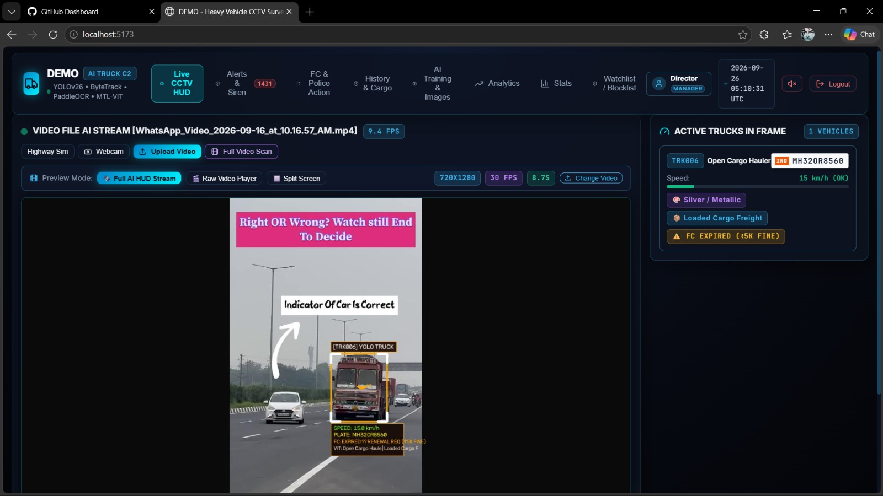
15
Screenshots
Fig. 1 Real-Time Truck Monitoring
.
19

Slide 20
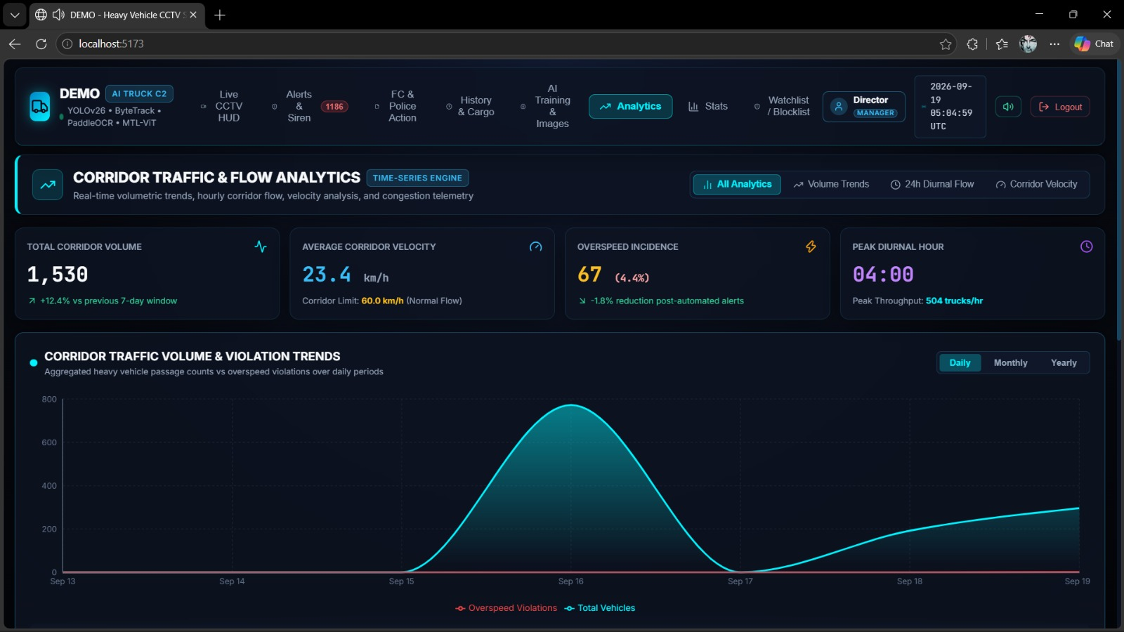
15
Screenshots
Fig. 2 —Corridor Traffic and Flow Analytics
.
19

Slide 21
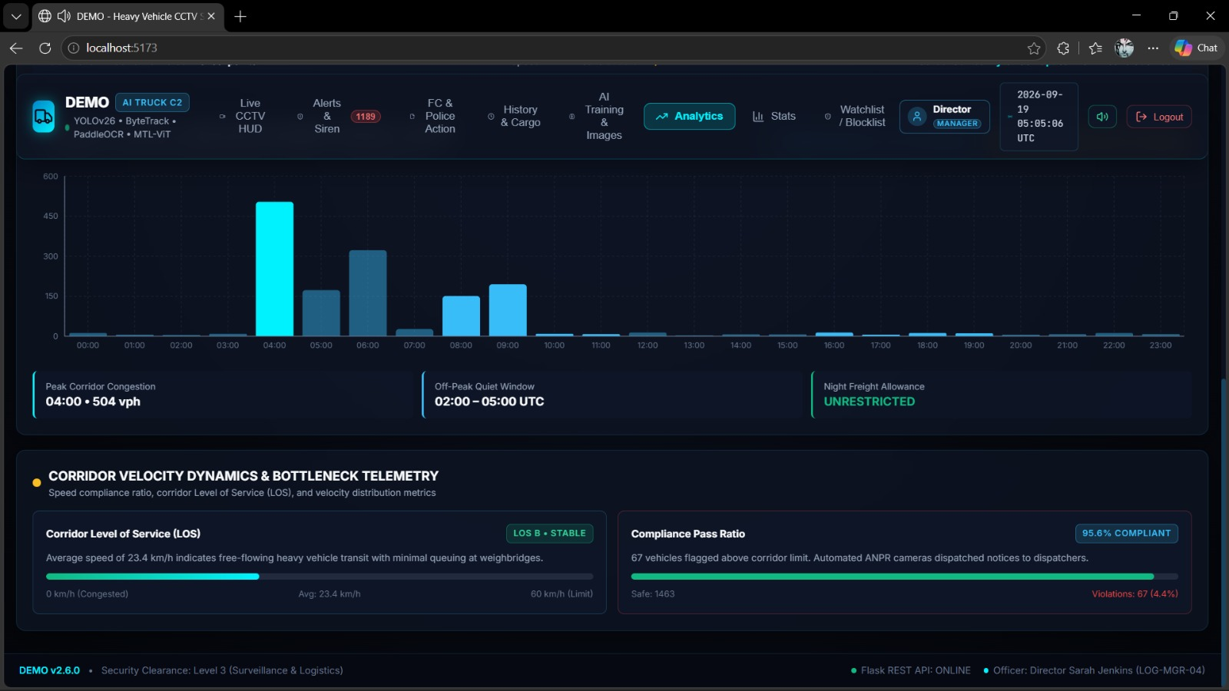
15
Screenshots
Fig. 3 — Speed Distribution and Compliance
19

Slide 22
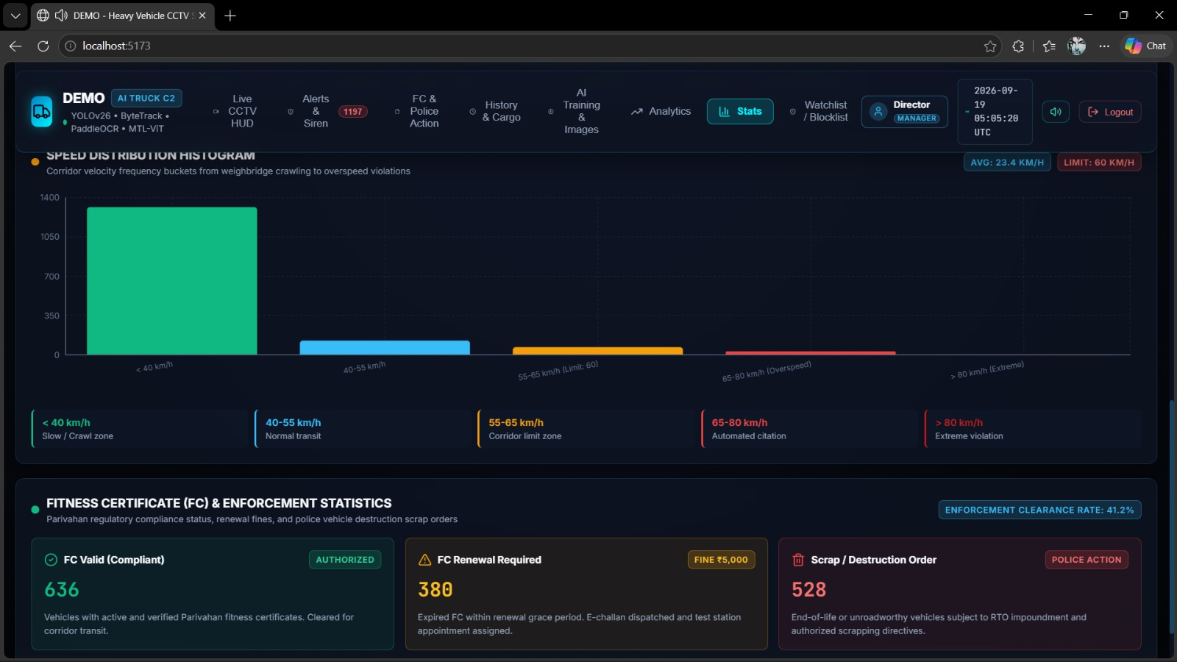
15
Screenshots
Fig. 4 — System Workflow
.
19

Slide 23
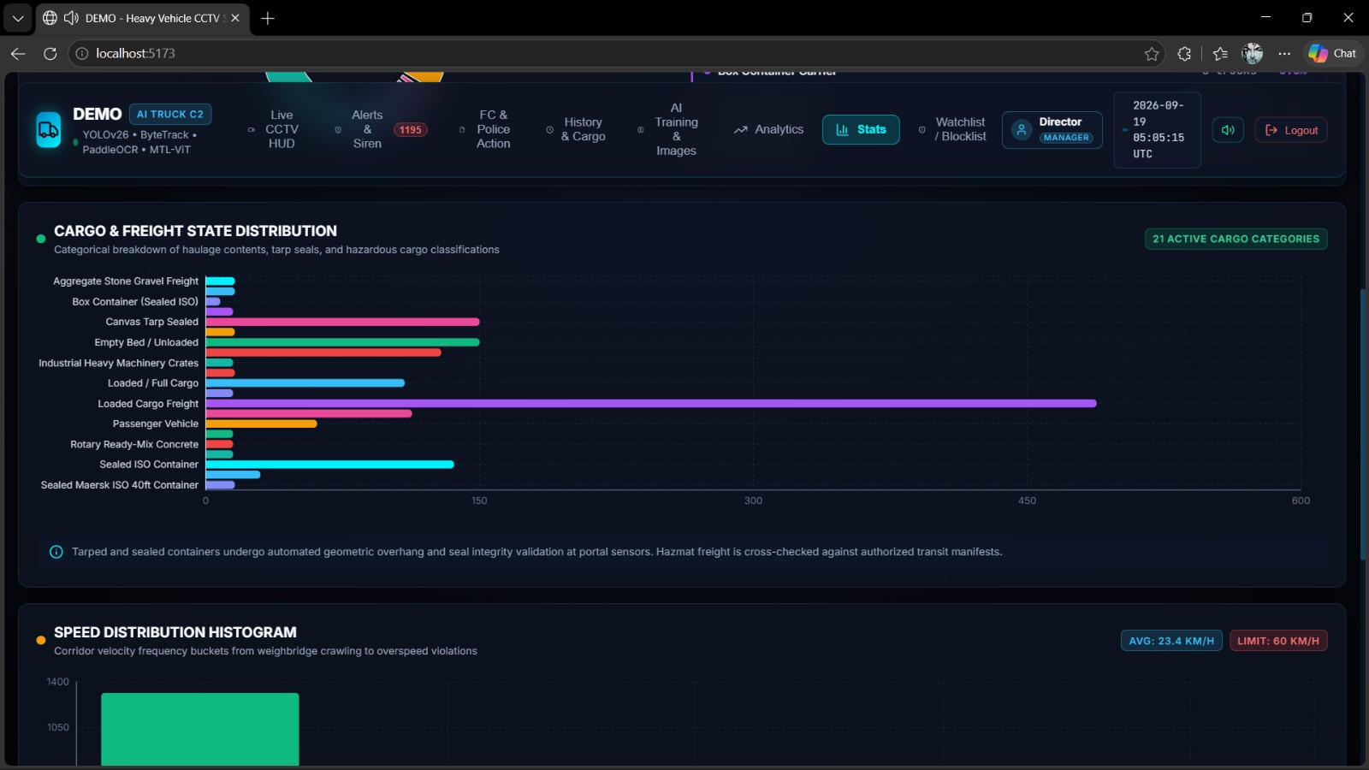
15
Screenshots
Fig. 5 — Fleet Statistics Dashboard
19

Slide 24
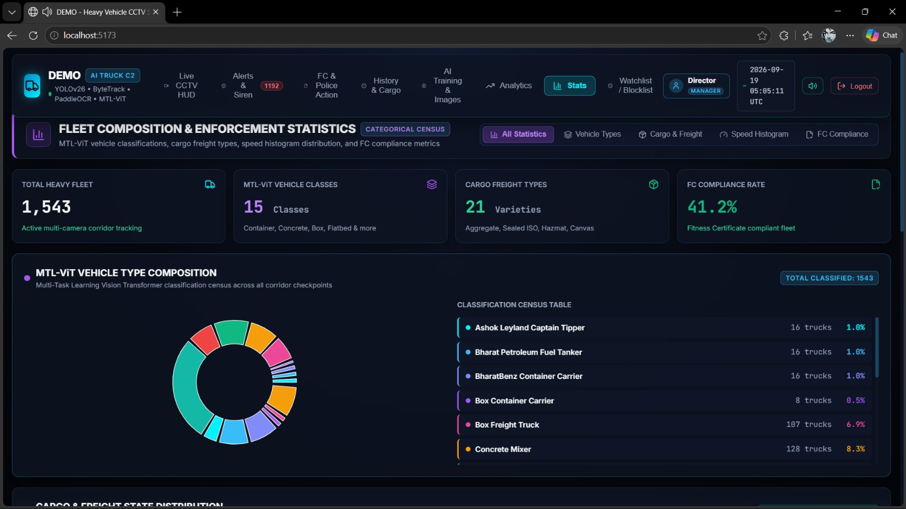
15
Screenshots
Fig. 6 —Cargo Distribution
.
19

Slide 25
16
Working Demonstration
1
A recorded/live CCTV video of a road or checkpoint is fed into the system as input.
2
The YOLO-based detector identifies each truck; ByteTrack assigns a persistent Track ID as it moves through the scene.
3
The system computes the truck's speed from its tracked trajectory and displays it alongside the bounding box.
4
The ALPR module detects and reads the truck's number plate in real time.
5
The classification module displays the predicted truck type, colour and visual attributes for the same tracked vehicle.
6
The recognised plate is checked against the blocklist; a match or an overspeed reading immediately raises a dashboard alert.
7
The React dashboard updates live with the new vehicle record, its attributes and any active alert; the event is stored in MySQL for later search.
20

Slide 26
17
Result and Discussion
Full-scale evaluation on the deployment dataset is still in progress. Figures below are sample/representative values based on ranges reported by comparable systems in the literature review.
Module | Metric | Representative Value*
Truck Detection (YOLO) | mAP@0.5 | ~92%
Multi-Object Tracking (ByteTrack) | ID-switch rate | Low, on typical traffic density
License Plate Recognition | Character accuracy | ~93–95%
Truck Classification (MTL-ViT) | Top-1 accuracy | ~90%
Speed Estimation | Mean absolute error | ±3–5 km/h
Alert Generation | End-to-end latency | < 2 seconds
*Sample/representative values for planning purposes; not yet based on final measured evaluation data. They are broadly consistent with the 93–95% OCR-accuracy range reported by the ALPR-focused papers surveyed, suggesting the chosen model choices are reasonable starting points. Because a valid alert depends on every stage working together, end-to-end alert latency is tracked as a system-level metric rather than evaluating modules in isolation.
AI-Based Intelligent Truck Monitoring and Risk Assessment System
21

Slide 27
18
Challenges Faced
Limited availability of a truck-specific, labelled dataset covering diverse truck types, colours and body attributes for training the MTL-ViT classification module.
Variability in lighting, weather and camera angle affecting both truck detection accuracy and ALPR readability, particularly at night or in rain.
Occlusion and ID-switching in dense traffic, which can break the persistent Track ID that downstream modules depend on.
Balancing real-time performance against accuracy — running detection, tracking, ALPR and classification concurrently is computationally demanding.
Integrating multiple independently developed modules (detection, tracking, OCR, classification, database, alerting) into one synchronised pipeline.
Sourcing and maintaining a realistic blocklist database for testing without access to an official registry.
Hardware constraints when scaling to process multiple simultaneous CCTV streams on available GPU resources.
22

